Slide 1
Distributed Database Management System (DDBMS)

Slide 2
Distributed Database Management System (DDBMS)
Distributed Database Management System (DDBMS) is a type of DBMS which manages a number of databases hoisted at diversified locations and interconnected through a computer network
A distributed database is a collection of multiple interconnected databases, which are spread physically across various locations that communicate via a computer network
It provides mechanisms so that the distribution remains oblivious to the users, who perceive the database as a single database

Slide 3
Features of DDBMS
Databases in the collection are logically interrelated with each other. Often they represent a single logical database.
Data is physically stored across multiple sites. Data in each site can be managed by a DBMS independent of the other sites.
The processors in the sites are connected via a network. They do not have any multiprocessor configuration.
A distributed database is not a loosely connected file system.
A distributed database incorporates transaction processing, but it is not synonymous with a transaction processing system.

Slide 4
Features of DDBMS
It is used to create, retrieve, update and delete distributed databases.
It synchronizes the database periodically and provides access mechanisms by the virtue of which the distribution becomes transparent to the users.
It ensures that the data modified at any site is universally updated.
It is used in application areas where large volumes of data are processed and accessed by numerous users simultaneously.
It is designed for heterogeneous database platforms.
It maintains confidentiality and data integrity of the databases.

Slide 5
Advantages of Distributed Databases
Modular Development − If the system needs to be expanded to new locations or new units, in centralized database systems, the action requires substantial efforts and disruption in the existing functioning. However, in distributed databases, the work simply requires adding new computers and local data to the new site and finally connecting them to the distributed system, with no interruption in current functions.
More Reliable − In case of database failures, the total system of centralized databases comes to a halt. However, in distributed systems, when a component fails, the functioning of the system continues may be at a reduced performance. Hence DDBMS is more reliable.
Better Response − If data is distributed in an efficient manner, then user requests can be met from local data itself, thus providing faster response. On the other hand, in centralized systems, all queries have to pass through the central computer for processing, which increases the response time.
Lower Communication Cost − In distributed database systems, if data is located locally where it is mostly used, then the communication costs for data manipulation can be minimized. This is not feasible in centralized systems.

Slide 6
Adversities of Distributed Databases
Need for complex and expensive software − DDBMS demands complex and often expensive software to provide data transparency and co-ordination across the several sites.
Processing overhead − Even simple operations may require a large number of communications and additional calculations to provide uniformity in data across the sites.
Data integrity − The need for updating data in multiple sites pose problems of data integrity.
Overheads for improper data distribution − Responsiveness of queries is largely dependent upon proper data distribution. Improper data distribution often leads to very slow response to user requests.

Slide 7
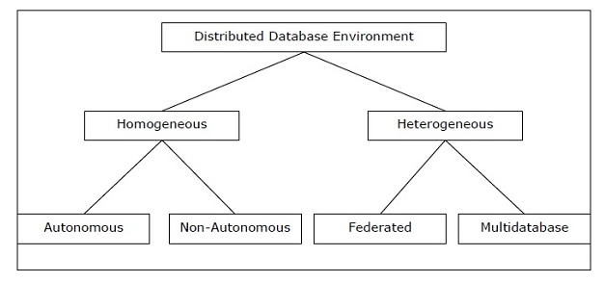
Types of Distributed Databases

Slide 8
Homogeneous Distributed Databases
In a homogeneous distributed database, all the sites use identical DBMS and operating systems
Its properties are −
The sites use very similar software
The sites use identical DBMS or DBMS from the same vendor
Each site is aware of all other sites and cooperates with other sites to process user requests
The database is accessed through a single interface as if it is a single database

Slide 9
Types of Homogeneous Distributed Database
There are two types of homogeneous distributed database −
Autonomous − Each database is independent that functions on its own. They are integrated by a controlling application and use message passing to share data updates.
Non-autonomous − Data is distributed across the homogeneous nodes and a central or master DBMS co-ordinates data updates across the sites

Slide 10
Heterogeneous Distributed Databases
In a heterogeneous distributed database, different sites have different operating systems, DBMS products and data models
Its properties are −
Different sites use dissimilar schemas and software.
The system may be composed of a variety of DBMSs like relational, network, hierarchical or object oriented.
Query processing is complex due to dissimilar schemas.
Transaction processing is complex due to dissimilar software.
A site may not be aware of other sites and so there is limited co-operation in processing user requests.

Slide 11
Types of Heterogeneous Distributed Databases
Federated − The heterogeneous database systems are independent in nature and integrated together so that they function as a single database system.
Un-federated − The database systems employ a central coordinating module through which the databases are accessed.

Slide 12
Distributed DBMS Architectures
DDBMS architectures are generally developed depending on three parameters −
Distribution − It states the physical distribution of data across the different sites.
Autonomy − It indicates the distribution of control of the database system and the degree to which each constituent DBMS can operate independently.
Heterogeneity − It refers to the uniformity or dissimilarity of the data models, system components and databases.

Slide 13
Architectural Models
Some of the common architectural models are −
Client - Server Architecture for DDBMS
Peer - to - Peer Architecture for DDBMS
Multi - DBMS Architecture

Slide 14
Client - Server Architecture for DDBMS
This is a two-level architecture where the functionality is divided into servers and clients
The server functions primarily encompass data management, query processing, optimization and transaction management
Client functions include mainly user interface. However, they have some functions like consistency checking and transaction management
The two different client - server architecture are −
Single Server Multiple Client
Multiple Server Multiple Client (shown in the following diagram)

Slide 15
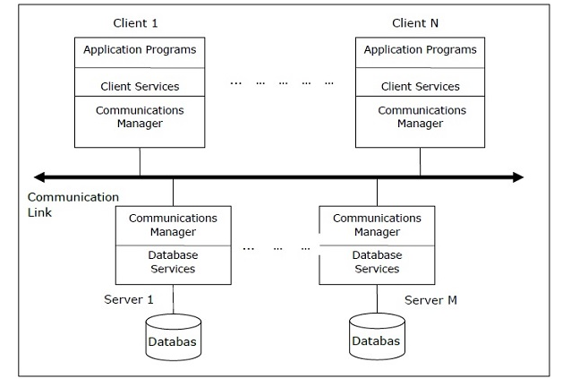
Client - Server Architecture for DDBMS

Slide 16
Peer- to-Peer Architecture for DDBMS
In these systems, each peer acts both as a client and a server for imparting database services
The peers share their resource with other peers and co-ordinate their activities
This architecture generally has four levels of schemas −
Global Conceptual Schema − Depicts the global logical view of data.
Local Conceptual Schema − Depicts logical data organization at each site.
Local Internal Schema − Depicts physical data organization at each site.
External Schema − Depicts user view of data.

Slide 17
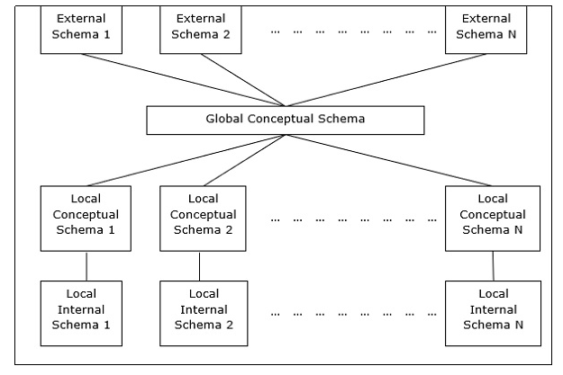
Peer- to-Peer Architecture for DDBMS

Slide 18
Multi - DBMS Architectures
This is an integrated database system formed by a collection of two or more autonomous database systems.
Multi-DBMS can be expressed through six levels of schemas −
Multi-database View Level − Depicts multiple user views comprising of subsets of the integrated distributed database.
Multi-database Conceptual Level − Depicts integrated multi-database that comprises of global logical multi-database structure definitions.
Multi-database Internal Level − Depicts the data distribution across different sites and multi-database to local data mapping.
Local database View Level − Depicts public view of local data.
Local database Conceptual Level − Depicts local data organization at each site.
Local database Internal Level − Depicts physical data organization at each site.

Slide 19
Multi - DBMS Architectures
There are two design alternatives for multi-DBMS −
Model with multi-database conceptual level
Model without multi-database conceptual level

Slide 20
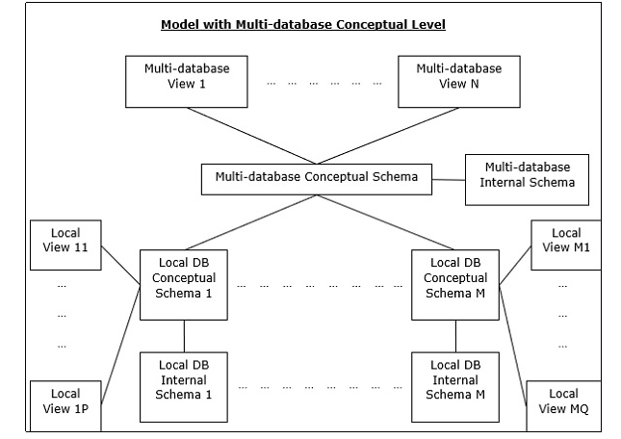
Model With Multi-database Conceptual level

Slide 21
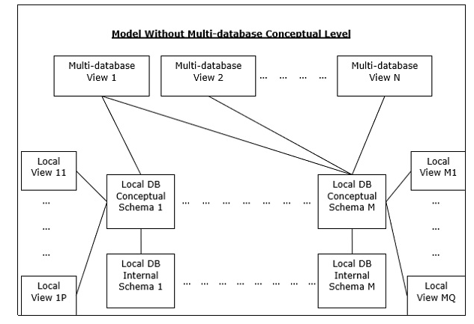
Model Without Multi-database Conceptual level

Slide 22
Design Alternatives
The distribution design alternatives for the tables in a DDBMS are as follows −
Non-replicated and non-fragmented
Fully replicated
Partially replicated
Fragmented
Mixed

Slide 23
Non-replicated & Non-fragmented
In this design alternative, different tables are placed at different sites.
Data is placed so that it is at a close proximity to the site where it is used most.
It is most suitable for database systems where the percentage of queries needed to join information in tables placed at different sites is low.
If an appropriate distribution strategy is adopted, then this design alternative helps to reduce the communication cost during data processing.

Slide 24
Fully Replicated
In this design alternative, at each site, one copy of all the database tables is stored.
Since, each site has its own copy of the entire database, queries are very fast requiring negligible communication cost.
On the contrary, the massive redundancy in data requires huge cost during update operations.
Hence, this is suitable for systems where a large number of queries is required to be handled whereas the number of database updates is low.

Slide 25
Partially Replicated
Copies of tables or portions of tables are stored at different sites.
The distribution of the tables is done in accordance to the frequency of access.
This takes into consideration the fact that the frequency of accessing the tables vary considerably from site to site.
The number of copies of the tables (or portions) depends on how frequently the access queries execute and the site which generate the access queries

Slide 26
Fragmented
In this design, a table is divided into two or more pieces referred to as fragments or partitions, and each fragment can be stored at different sites.
This considers the fact that it seldom happens that all data stored in a table is required at a given site.
Moreover, fragmentation increases parallelism and provides better disaster recovery.
Here, there is only one copy of each fragment in the system, i.e. no redundant data.
The three fragmentation techniques are −
Vertical fragmentation
Horizontal fragmentation
Hybrid fragmentation

Slide 27
Mixed Distribution
This is a combination of fragmentation and partial replications.
Here, the tables are initially fragmented in any form (horizontal or vertical), and then these fragments are partially replicated across the different sites according to the frequency of accessing the fragments.

